Slide 1

Design of Discrete-Time Matrix All-Pass Filter
Using Subspace Nevanlinna-Pick Interpolation
Name: Agulla Surya Bharath — Roll.No: 17D070055
Guide: Prof. Kumar Appaiah — Co-Guide: Prof Debasattam Pal

Slide 2
Motivation
→ Use of multiple antennas at Tx and Rx (MIMO) enhances the rates in wireless communications .
→ Optimal resource allocation requires channel state knowledge at transmitter - enabled by feedback from receiver .
Channel State Information
T_{x}
Data symbols
R_{X}
T_{X}
Precoded data symbols
R_{X}
👎
👍
→ Constraint : Feedback link is highly limited in rate (Limited Feedback)
R_{X}
Full Feedback
T_{X}
R_{X}
Limited Feedback
T_{X}
👎
👍

Slide 3
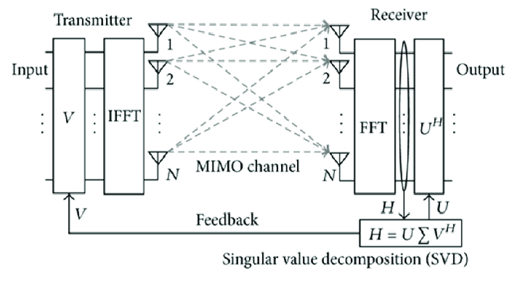
Importance of Unitary Matrices
→ MIMO - OFDM System
→ Multiple subcarriers
→ Unitary matrix feedback - used as precoder
at the transmitter
Figure: Block Diagram for SVD in MIMO-OFDM
→ Large amount of feedback required to send precoder(V) for every sub-carrier frequency
→ Need a technique to reduce unitary matrix feedback rate
Image Source : https://www.researchgate.net/figure/Block-diagram-for-SVD-in-MIMO-OFDM_fig1_273824105

Slide 4
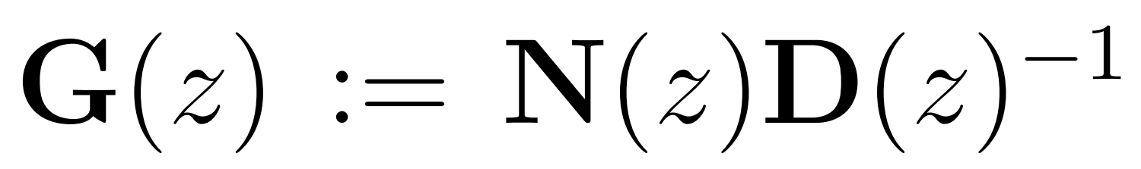
Possible Solutions
DFT - Interpolation^{[9],[10]}
→ OLD
→ Send precoder (unitary) matrices for some subcarriers
→ Interpolate precoder for other subcarriers in frequency domain (Eg. On Grassmann manifold)
Disadvantage : Error prone - time domain realizations - Non Linear - Complex computations ^{[11]}
2. Filter Design method
→ NEW , our work
→ Unitary matrix ≣ All-Pass system
→ Design a rational matrix all-pass filter - - fits the feedback unitary data
Advantage : Realizable filter - compact representation & accelerated implementations
[9] D. J. Love, R. W. Heath, V. K. N. Lau, D. Gesbert, B. D. Rao and M. Andrews, "An overview of limited feedback in wireless communication systems," in IEEE Journal on Selected Areas in Communications, vol. 26, no. 8, pp. 1341-1365, October 2008, doi: 10.1109/JSAC.2008.081002
[10] J. Choi, B. Mondal, and R. W. Heath, \Interpolation based unitary pre-coding for spatial multiplexing MIMO-OFDM with limited feedback"
[11] D. J. Love, R. W. Heath, W. Santipach, and M. L. Honig, \What is the value of limited feedback for MIMO channels?"

Slide 5
Block Diagram of our method
Construct the filter
&
Generate all precoders
T_{x}
R_{X}
Estimate channel matrix
Compute precoders for all subcarriers
Pilot symbols
Matrix all-pass filter coefficients
Pick few subcarriers’ precoders & design filter
Feedback coefficients
→ Limited feedback is achieved & less implementation complexity on Tx side

Slide 6



Prior Work / Literature Review
→ First we look at scalar version problem of all-pass filters
- Classical Nevanlinna - Pick problem (NP)
NP has a solution iff the Pick matrix P is positive semi definite ( P ≥ 0)
f(z₃)
z₃
z₁
f(z₁)
z₂
f(z₂)
- Boundary version of NP^{[1]}
:
Solved using
Blaschke Product
z₃
f(z₃)
Diagonal Elements of P = ⇒ NP fails here
z₁
f(z₁)
z₂
P_{ii} =
f(z₂)
⇾ Group Delay
[1] V. Bolotnikov, “Boundary interpolation by finite Blaschke products,” in Complex Analysis and Dynamical Systems. Springer, 2018, pp. 39–65.
[2] K. Appaiah and D. Pal, “All-pass filter design using blaschke interpolation,” IEEE Signal Process. Lett., vol. 27, pp. 226–230, 2020.

Slide 7
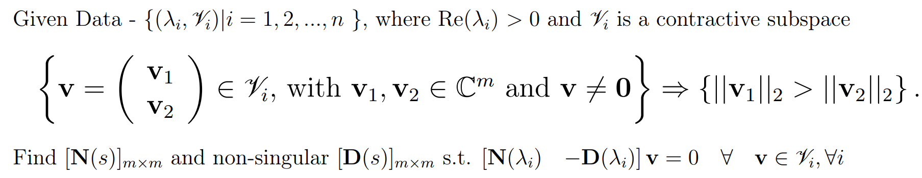
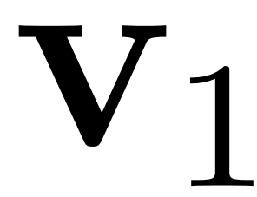
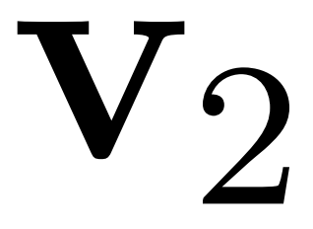
Prior Work / Literature Review
→ Subspace Nevanlinna Interpolation (SNIP) ^{[3]}
Problem Statement :
D(.)⁻¹N(.)
Uses iterative approach to pass the model through all data points
Pick matrix - Positive definite - Necessary & Sufficient
[3] P. Rapisarda and J. C. Willems, “The subspace nevanlinna interpolation problem and the most powerful unfalsified model,” in Proceedings of the 36th IEEE Conference on Decision and Control, vol. 3, 1997, pp. 2029–2033 vol.3.

Slide 8
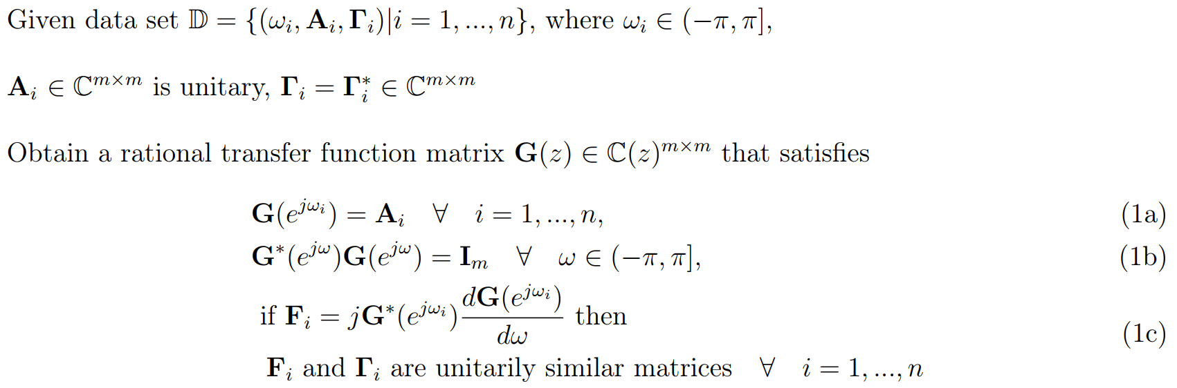
Discrete-Time Matrix All-Pass Filter
→ Problem Statement (Boundary SNIP):
[13] S. Fan and J. M. Kahn. Principal modes in multimode waveguides,. Optics Letters 30(2):135–137, 2005.

Slide 9
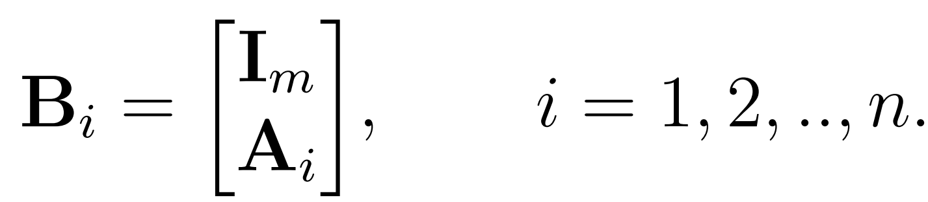
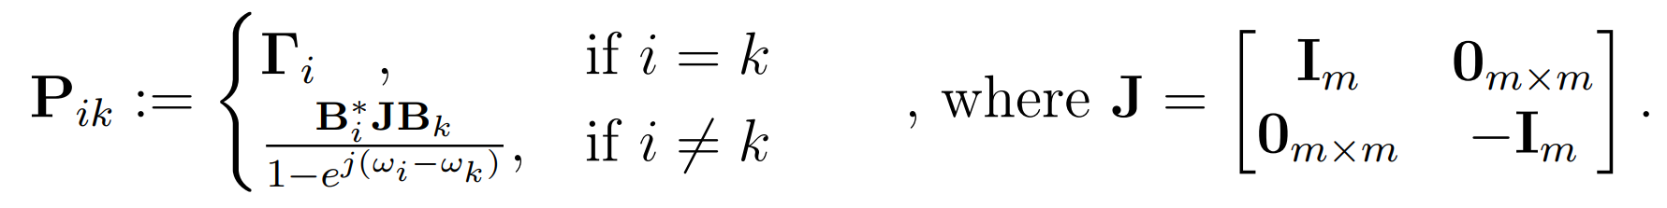
Formulating the Modified Pick Matrix
→ Modify the data-set to capture contractive subspace ,
→ Modified Pick Matrix of size nm x nm. It’s m x m submatrices are defined as follows,
( Eq. 2 )

Slide 10

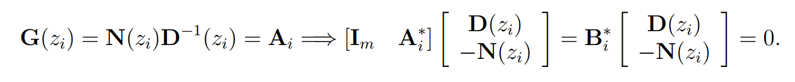
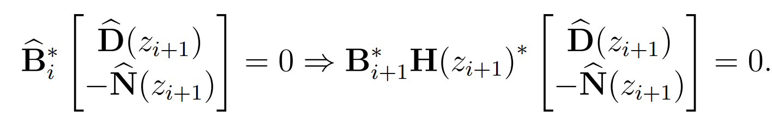
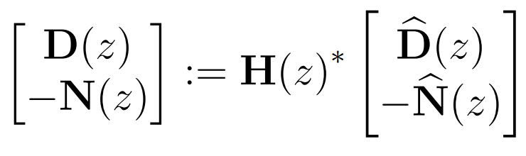
Induction Based Solution

Slide 11
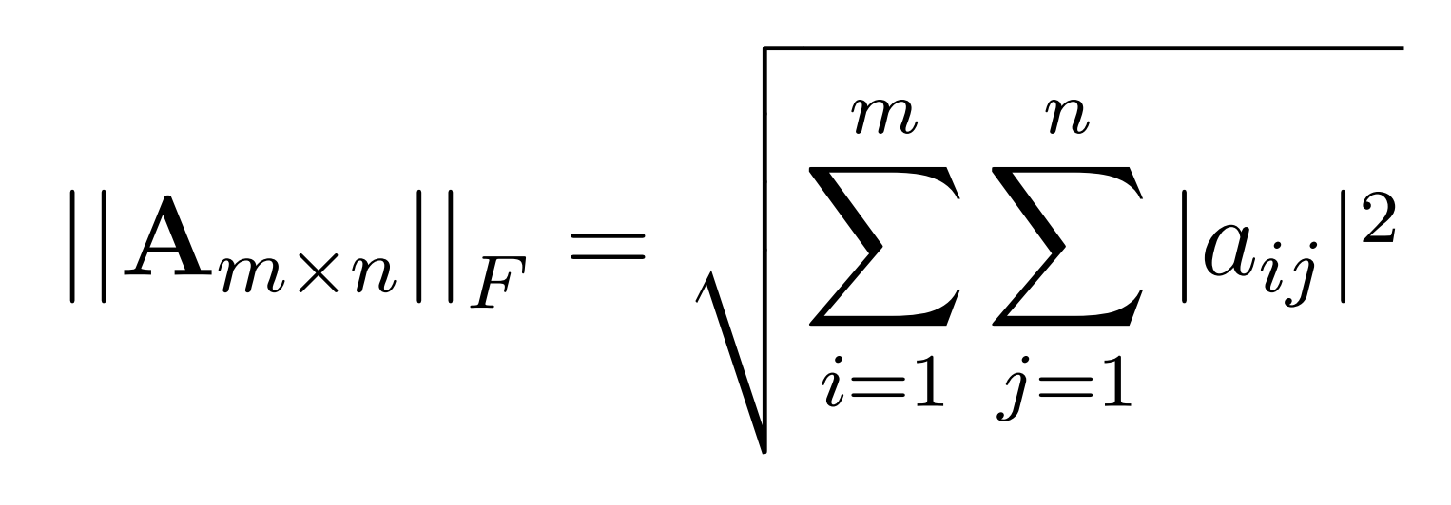
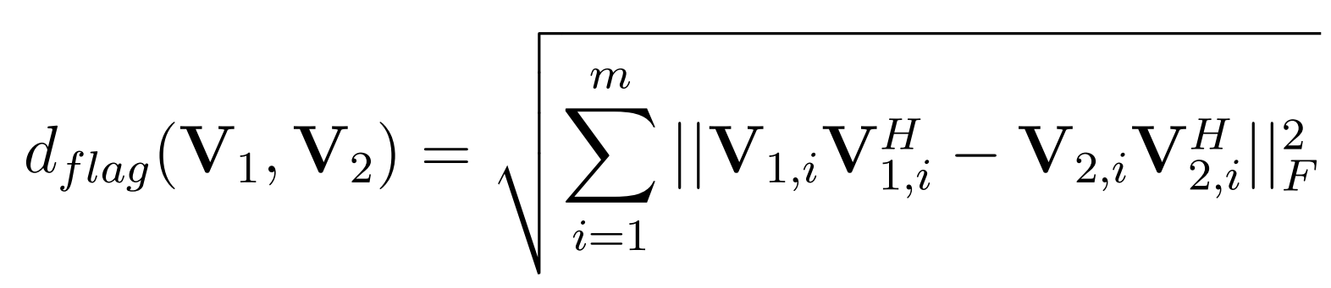
Simulation results
Distances to measure the error:
Frobenius Norm:
Flag Distance:
→ Measures the distance between matrices under the unitary diagonal matrix
multiplication being an equivalent constraint - used for precoding in MIMO-OFDM.
[20] S. Nijhawan, A. Gupta, K. Appaiah, R. Vaze, and N. Karamchandani. Flag Manifold- Based Precoder Interpolation Techniques for MIMO-OFDM Systems. 69(7):4347–4359, 2021.

Slide 12
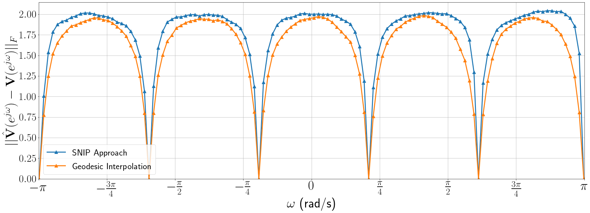
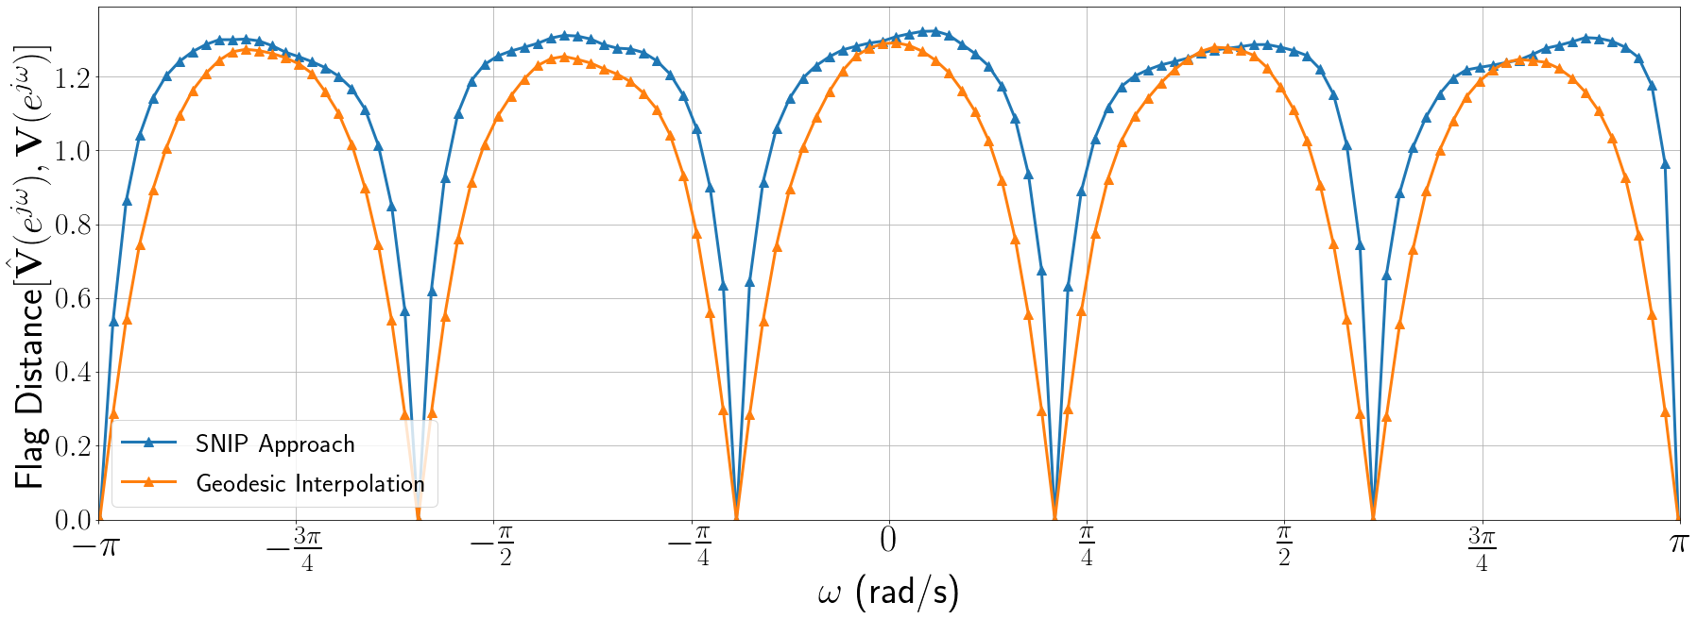
Simulation Results : 2𝘹2 MIMO
Unitary Matrix Data : SVD of Channel Matrix (H ) of MIMO wireless system
Channel: ITU Vehicular A
Size of Data-set = 6
Error averaged over 1000 channel iterations
[10] N. Khaled, B. Mondal, R.W. Heath, G. Leus, and F. Petre. Quantized multi-mode precoding for spatial multiplexing mimo-ofdm system. In VTC-2005-Fall. 2005 IEEE 62nd Vehicular Technology Conference, 2005., volume 2, pages 867–871, 2005.

Slide 13
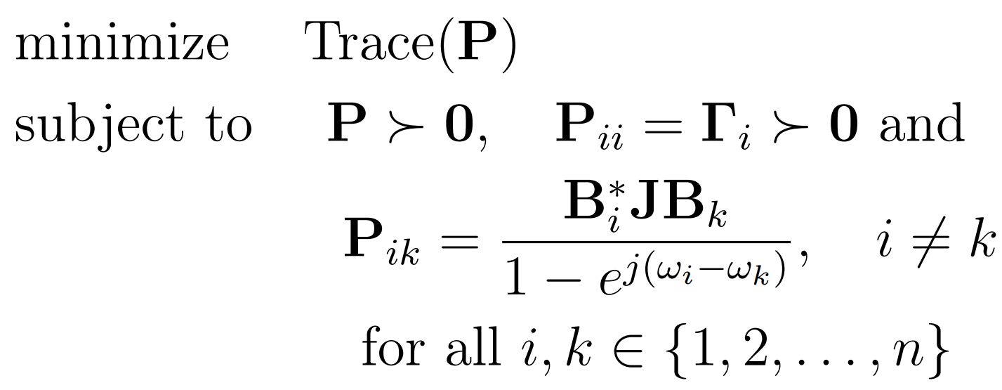
Optimizing the Group Delay
→ Minimize the sum of traces of group delay matrices (i.e Trace of pick matrix P)

Slide 14
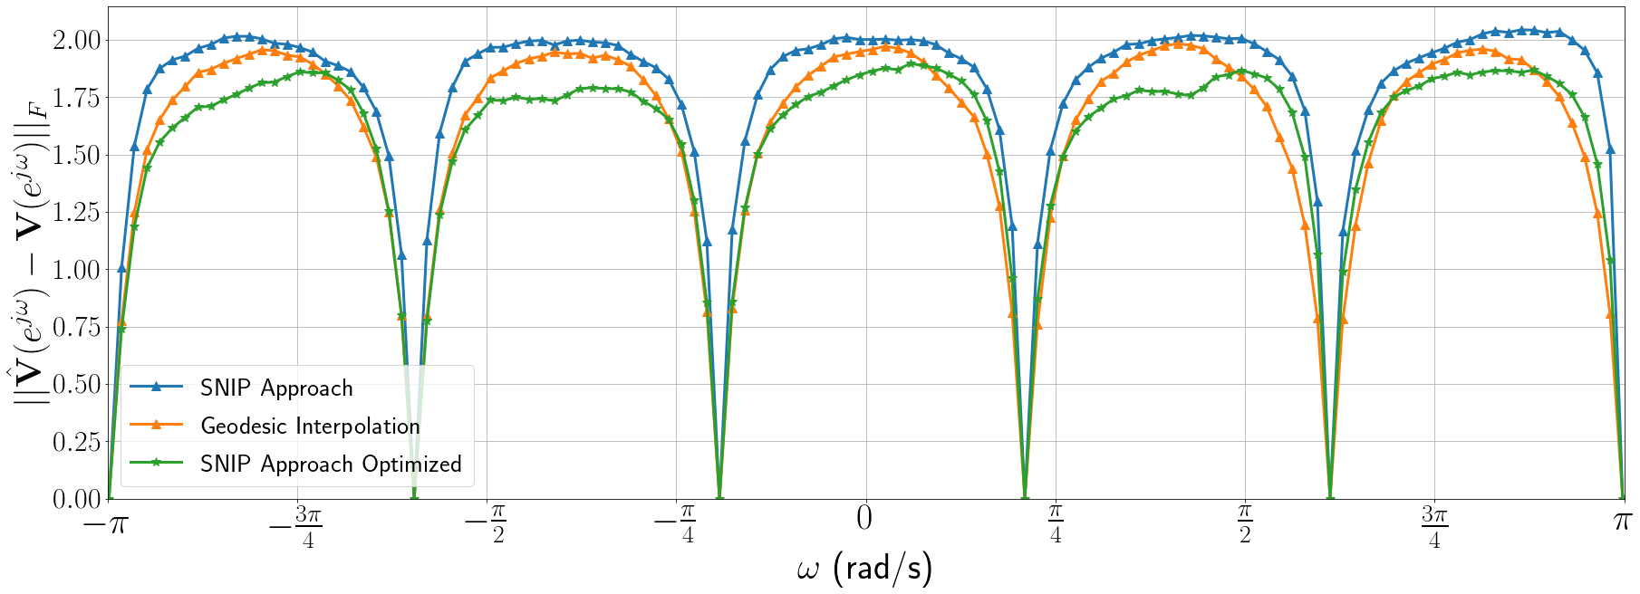
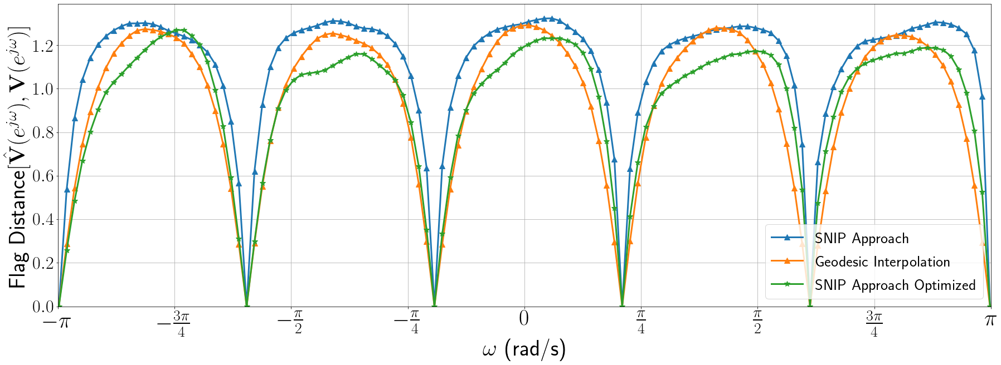
Simulation Results: 2𝘹2 MIMO (Group Delay Optimization)

Slide 15
Computational Benefits
Matrix Filtering approach is better than Geodesic: ≊ 8X faster (in TIME) & ≊ 1.2X Low (in MEMORY)
mXm MIMO | SNIP Approach (in ms) | Geodesic (in ms)
m = 2 | 0.5665 | 4.8178
m = 3 | 0.5917 | 5.7858
m = 4 | 0.6006 | 6.0138
m = 5 | 0.6189 | 6.0593
m = 6 | 0.6542 | 6.1430
m = 7 | 0.8176 | 6.9861
mXm MIMO | SNIP Approach (in KB) | Geodesic (in KB)
m = 2 | 3.3971 | 6.4022
m = 3 | 4.4769 | 7.0285
m = 4 | 5.7518 | 7.6951
m = 5 | 7.0732 | 8.9847
m = 6 | 8.6007 | 10.7569
m = 7 | 9.7012 | 11.2269
Tab 1. Average time taken per precoder construction
Tab 2. Average peak size used per precoder construction
[23] Google Inc. Google colaboratory.

Slide 16
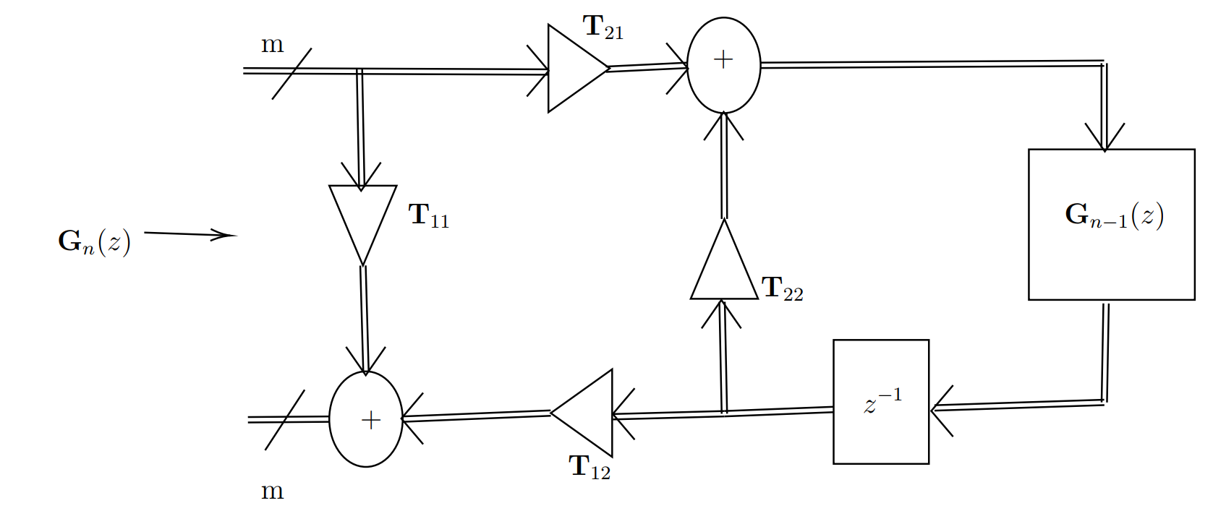
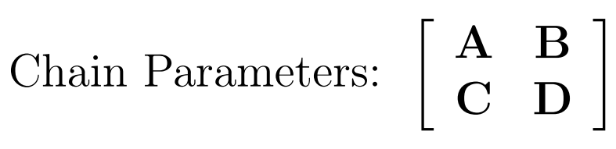
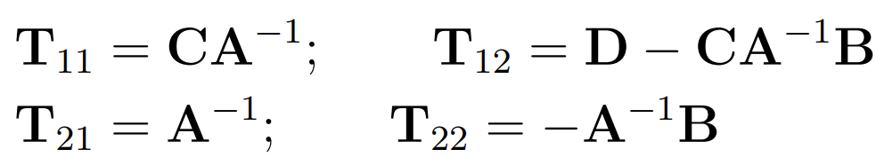

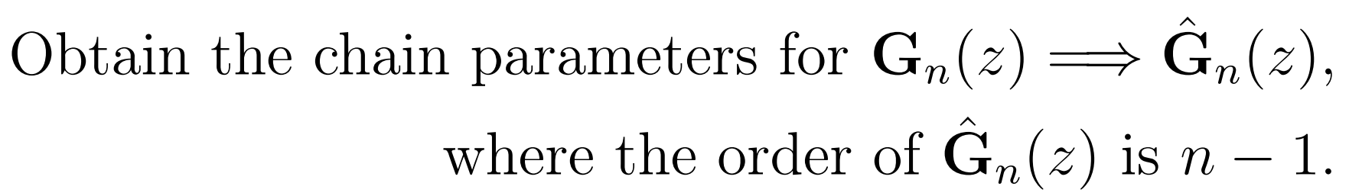
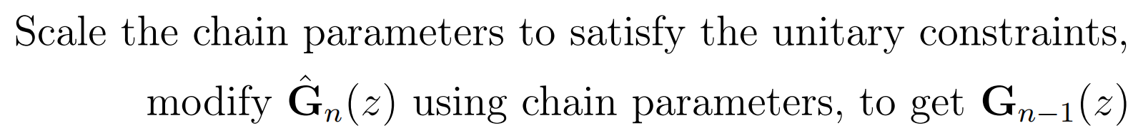
Lattice Structure Realization
Figure: The matrix all-pass two pair lattice
Step 1: Order Reduction →
Step 2: Retaining the Unitary nature →
[25] P. Vaidyanathan and S. Mitra. A general family of multivariable digital lattice filters. IEEE Transactions on Circuits and Systems, 32(12):1234–1245, 1985.

Slide 17
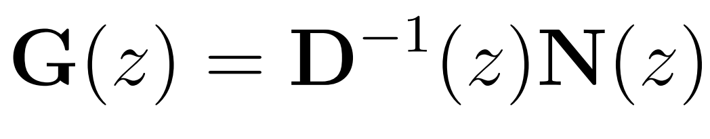
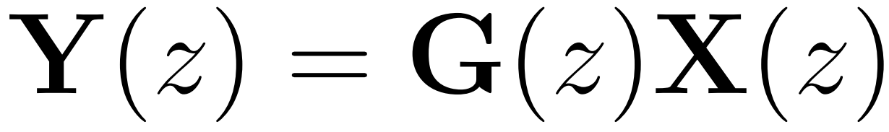
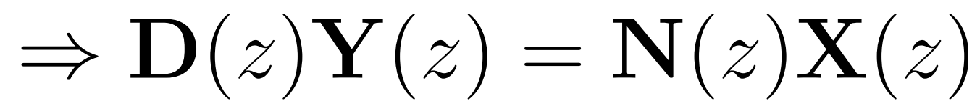
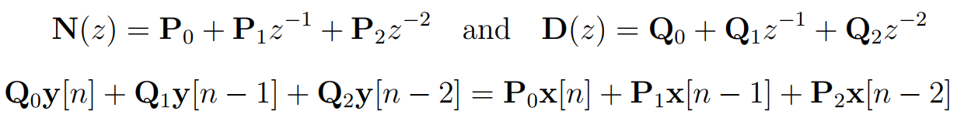
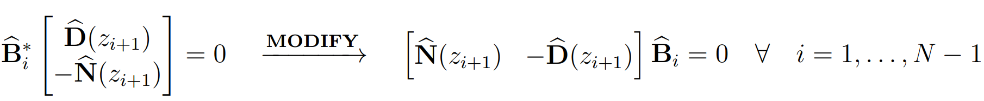
Left Coprime Factorized Matrix All-Pass
→ Advantages incurred by realizations via clean LCCDE (Direct form - I & II implementation)
→ Changes to be made in the design:
Solution in “base step” changes accordingly
2.

Slide 18
Quantization Effects
→ Data rate constraints
→ Retain the all-pass nature of filter - after quantization
→ Two methods to quantize matrix all-pass filter:
Quantize the coefficients of designed filter
→ K-means on grassmann manifold (Linear approximation)
Quantize the unitary matrices in the data-set
→ K-means with frobenius norm as error measure

Slide 19
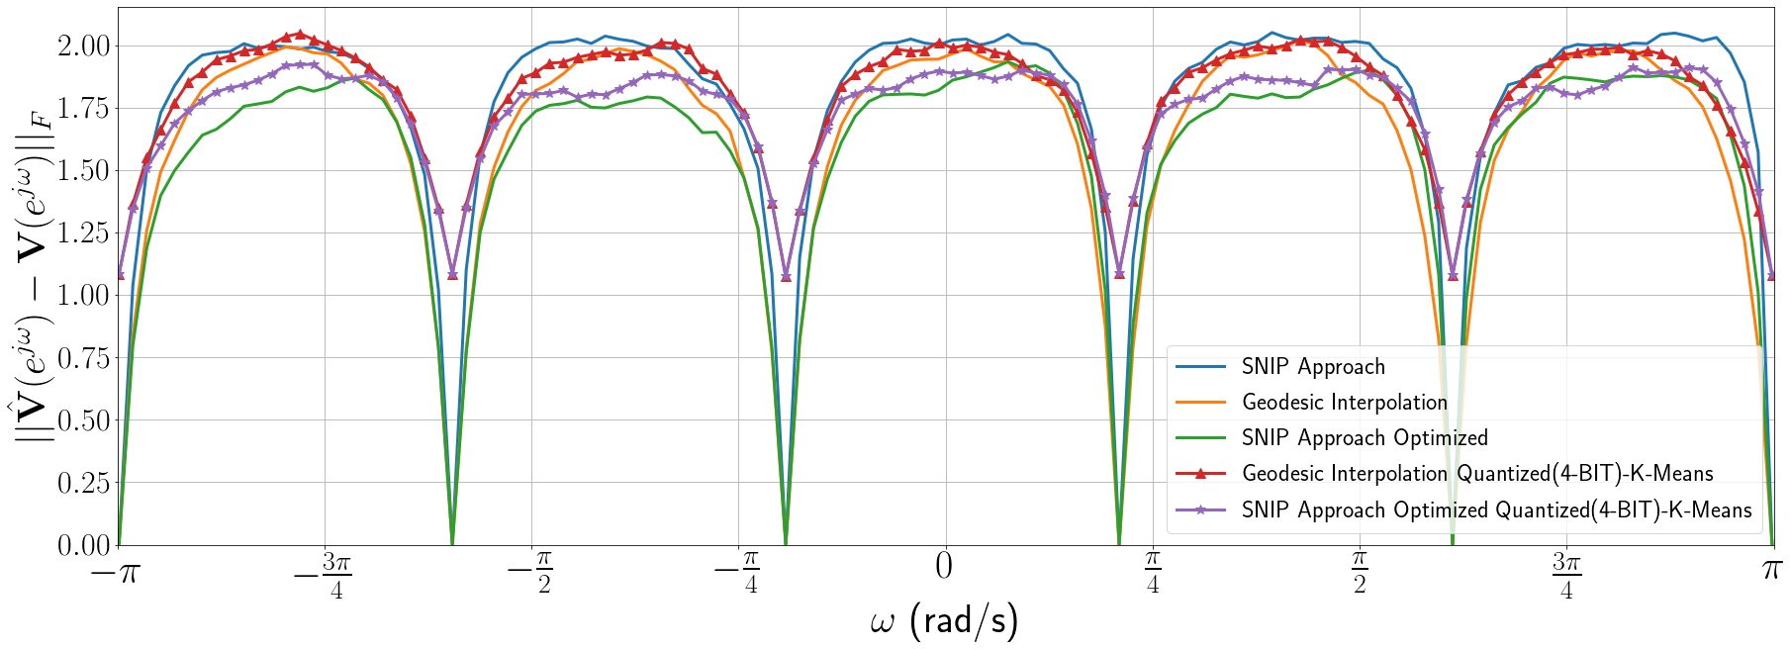
Quantizing the Unitary Data-set

Slide 20
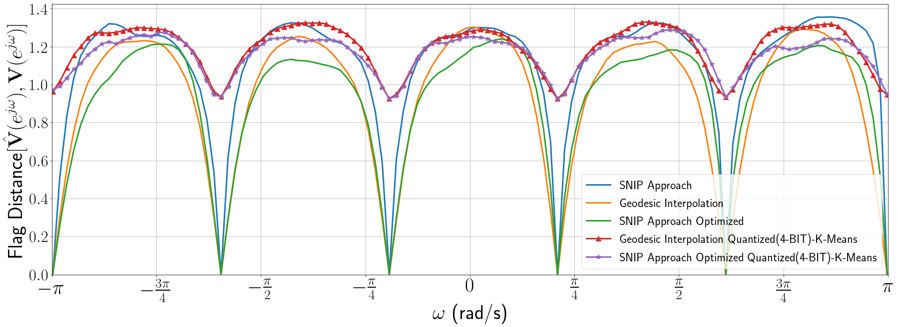
Quantizing the Unitary Data-set

Slide 21
Future Work
→ Ways to generate a good data-set that minimizes overfitting and improves the
performance optimally (Eg. Optimize group delays)
→ Applications of lattice structure realization in adaptive filtering
→ Explore the structure of matrix all-pass filter - helps in efficient quantization
→ Stability conditions on the designed matrix all-pass filter.
→ Applications in massive-MIMO & stereo audio processing
→ Modify the unitary data to reduce the redundancy
→ Generalize the matrix filtering (Eg. Skew hermitian).

Slide 22
References
[1] D.J. Love and R.W. Heath. Multimode precoding for mimo wireless systems. 53(10):3674–3687, 2005.
[2] H. Karaa, R. S. Adve, and A. J. Tenenbaum. Linear precoding for multiuser mimoofdm systems. In 2007 IEEE International Conference on Communications, pages 2797–2802, 2007.
[3] David J. Love, Robert W. Heath, Vincent K. N. Lau, David Gesbert, Bhaskar D. Rao, and Matthew Andrews. An overview of limited feedback in wireless communication systems. 26(8):1341–1365, 2008.
[4] D. J. Love and R. W. Heath. Limited feedback unitary precoding for spatial multiplexing systems. 51(8):2967–2976, 2005.
[5] P. Rapisarda and J. C. Willems. The Subspace Nevalinna Interpolation Problem and the most powerful unfalsified model. In 36th IEEE Conference on Decision and Control, volume 3, pages 2029–2033, 1997.
[6] M. Saito D.C. Youla. Interpolation with positive real functions. Journal of the Franklin Institute, 284, Issue 2:77–108, 1967.
[7] K. Appaiah and D. Pal. All-pass filter design using Blaschke interpolation. 27:226–230, 2020.
[8] Vladimir Bolotnikov. Boundary Interpolation by Finite Blaschke Products. In Complex Analysis and Dynamical Systems, pages 39–65. Springer, 2018.
[9] Nadia Khaled, Bishwarup Mondal, Geert Leus, Robert W. Heath, and Frederik Petre. Interpolation-based multi-mode precoding for mimo-ofdm systems with limited feedback. 6(3):1003–1013, 2007.
[10] N. Khaled, B. Mondal, R.W. Heath, G. Leus, and F. Petre. Quantized multi-mode precoding for spatial multiplexing mimo-ofdm system. In VTC-2005-Fall. 2005 IEEE 62nd Vehicular Technology Conference, 2005., volume 2, pages 867–871, 2005.
[11] D.J. Love, R.W. Heath, W. Santipach, and M.L. Honig. What is the value of limited feedback for MIMO channels? 42(10):54–59, 2004.
[12] D. Tse and P. Viswanath. Fundamentals of Wireless Communication. Cambridge University Press, 2005.
[13] S. Fan and J. M. Kahn. Principal modes in multimode waveguides,. Optics Letters 30(2):135–137, 2005.
[14] J. C. Willems. Dissipative Dynamical Systems Part I: General Theory. Archive for Rational Mechanics and Analysis, 45(5):321–351, January 1972.
[15] Osamu Kaneko and Takao Fujii. Discrete-time average positivity and spectral factorization in a behavioral framework. Systems & Control Letters, 39(1):31–44, 2000.

Slide 23
References
[16] H.L. Trentelman and J.C. Willems. Every storage function is a state function. Systems & Control Letters, 32(5):249–259, 1997. System and Control Theory in the Behavioral Framework.
[17] Jean H. Gallier. Notes on the Schur Complement. December 2010.
[18] Jihoon Choi, Bishwarup Mondal, and Robert W. Heath. Interpolation based unitary precoding for spatial multiplexing mimo-ofdm with limited feedback. 54(12):4730– 4740, 2006.
[19] ITU-R Recommendation. Guidelines for evaluation of radio transmission technologies for imt-2000. Rec. ITU-R M. 225, 1997.
[20] S. Nijhawan, A. Gupta, K. Appaiah, R. Vaze, and N. Karamchandani. Flag Manifold- Based Precoder Interpolation Techniques for MIMO-OFDM Systems. 69(7):4347–4359, 2021.
[21] Renaud-Alexandre Pitaval, Ashvin Srinivasan, and Olav Tirkkonen. Codebooks in flag manifolds for limited feedback mimo precoding. In SCC 2013; 9th International ITG Conference on Systems, Communication and Coding, pages 1–5. VDE, 2013.
[22] Renaud-Alexandre Pitaval. Coding on flag manifolds for limited feedback mimo systems. 2013.
[23] Google Inc. Google colaboratory.
[24] Wei Dai, Youjian Liu, Brian Rider, and Vincent K. N. Lau. On the information rate of mimo systems with finite rate channel state feedback using beamforming and power on/off strategy. IEEE Transactions on Information Theory, 55(11):5032–5047, 2009.
[25] P. Vaidyanathan and S. Mitra. A general family of multivariable digital lattice filters. IEEE Transactions on Circuits and Systems, 32(12):1234–1245, 1985.

Slide 25
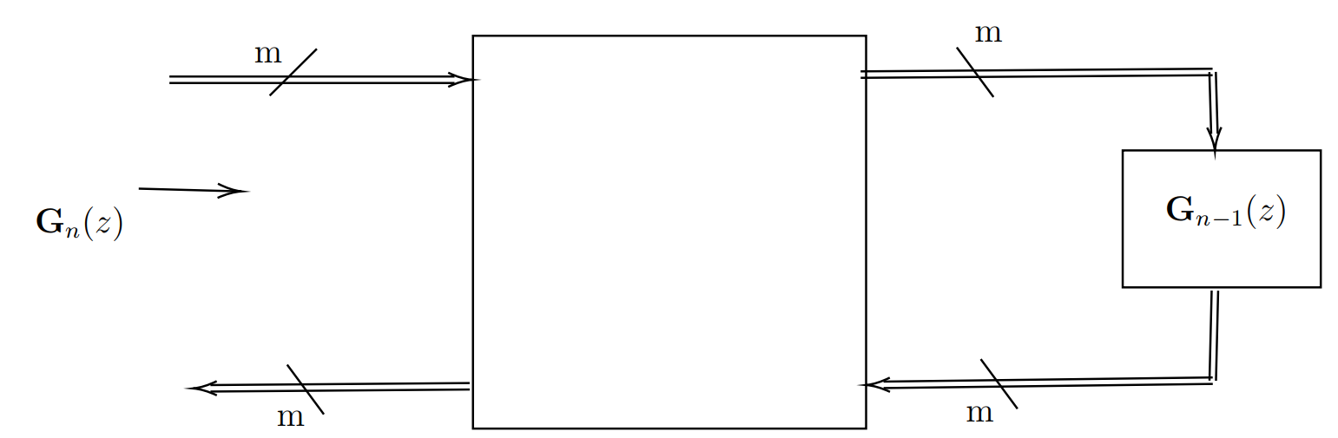
Lattice Structure Realization
Figure: Matrix two-pair extraction
Advantages:
→ Realizable structure - cascade of matrix two-pair, separated by vector delays
[25] P. Vaidyanathan and S. Mitra. A general family of multivariable digital lattice filters. IEEE Transactions on Circuits and Systems, 32(12):1234–1245, 1985.

Slide 26
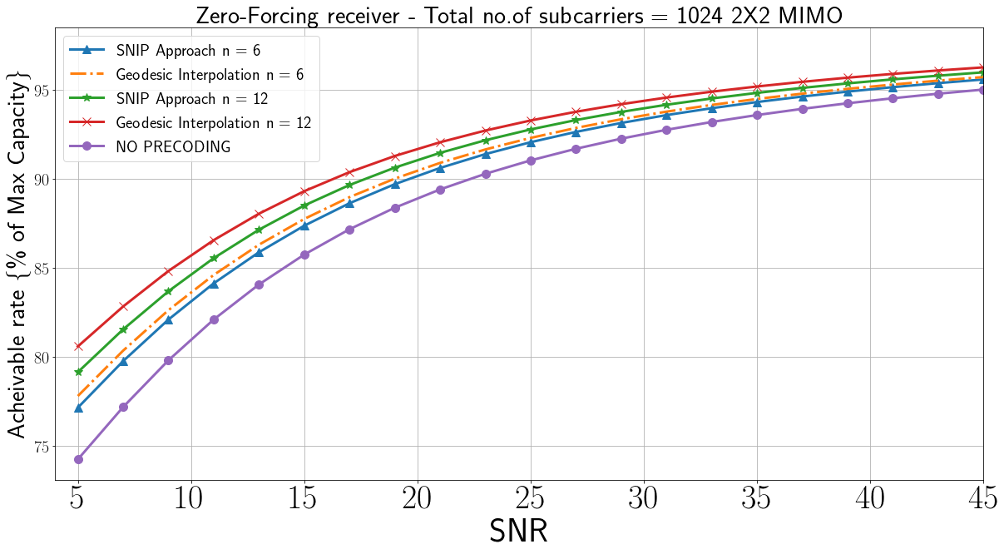
Achievable rates

Slide 27
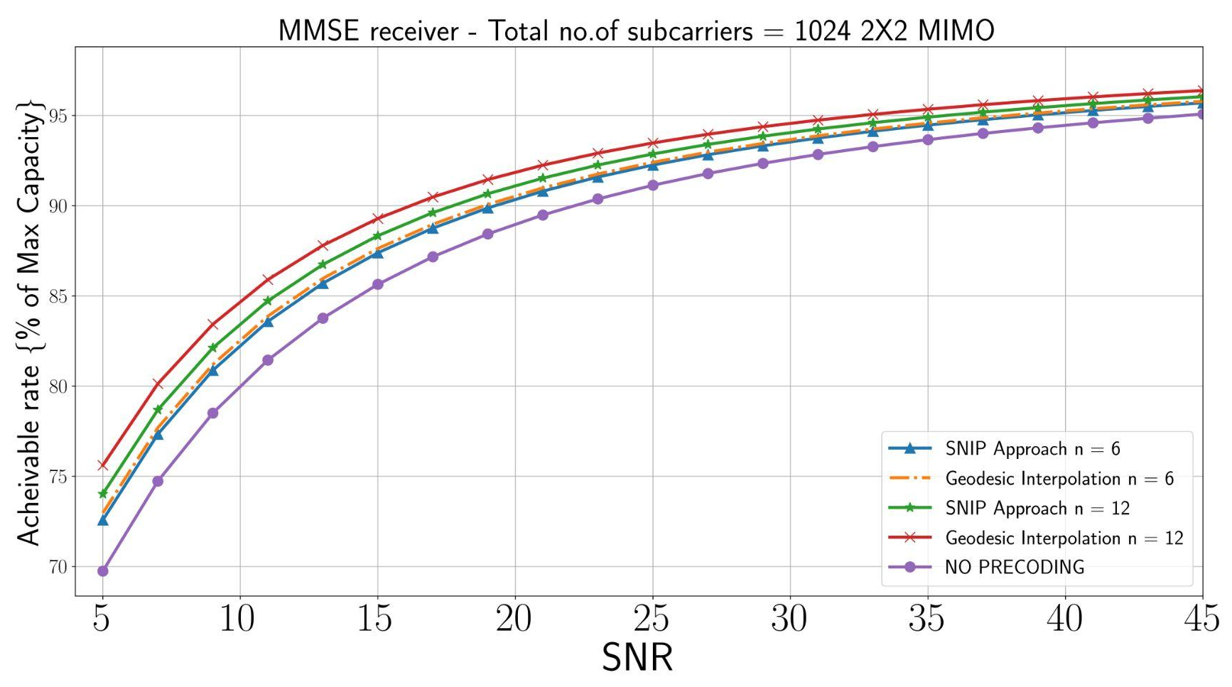
Achievable rates

Slide 28
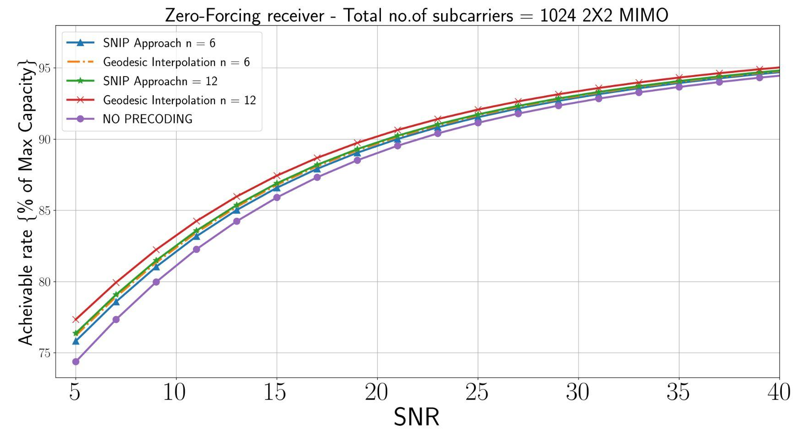
Achievable rates (Quantized)

Slide 29
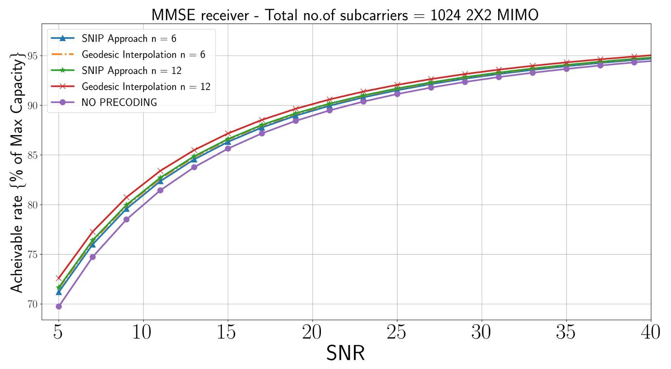
Achievable rates (Quantized)

